Slide 1

Stage 4 Smooth-brain Criminal Course Designer: Eric Beerbaum
Smooth-brain Criminal is a 20 round, 100 point Comstock medium course. There are 8 USPSA targets and 4 steel targets. The best two hits per target will score. Steel must fall to score. The start signal is audible.
The start position is standing with both feet touching Xs, facing downrange. Handgun loaded and holstered, wrists below belt. PCC loaded, stock on belt, muzzle pointing down range.
On the audible start signal, engage targets as visible from within the shooting areas.

Slide 2
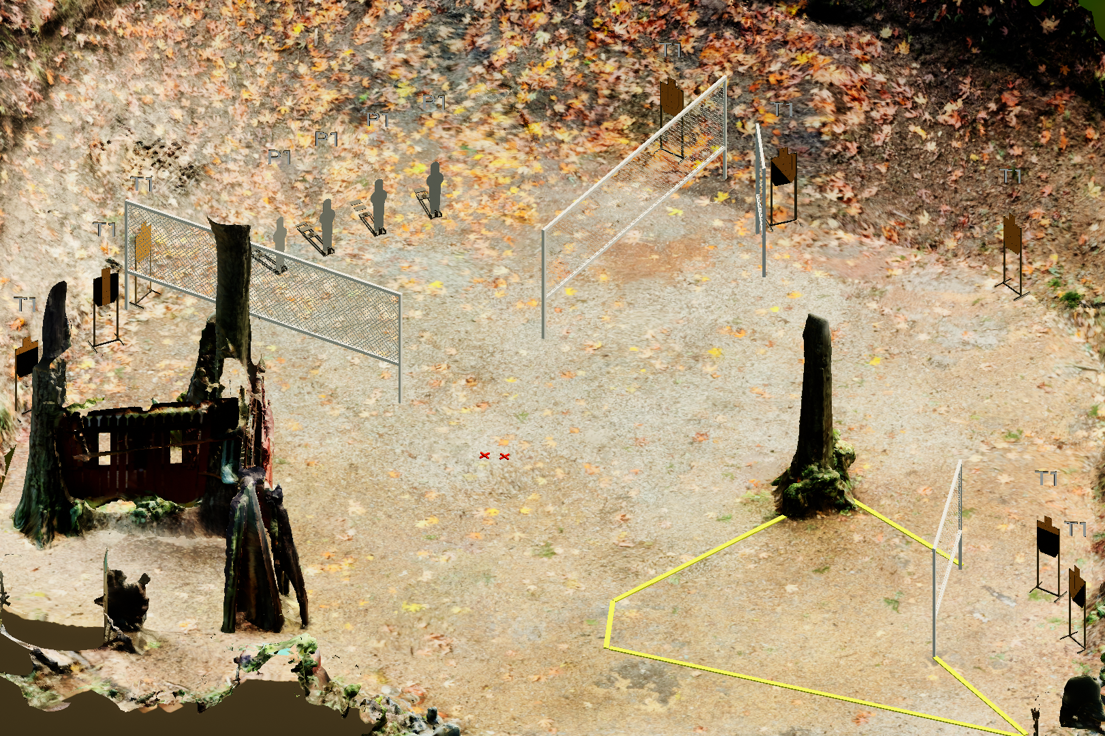
 | Stage 4 Smooth-brain Criminal Course Designer: Eric Beerbaum

